Slide 1
ECCC 2013

Slide 2
History
Numerous Ethernet & TCP/IP solutions for the Commodore 64 since 2003!
The Final Ethernet, RR-Net, FB-Net, 64NIC+ all based on CS8900 chip
Plus other unique solutions: Comet, Flyer, ETH64, Wiz5100, RN-XV
Plenty of tools – Disk imaging, File transfer, Telnet clients, Cross-development, Operating Systems (Contiki), etc.
How about some games?

Slide 3
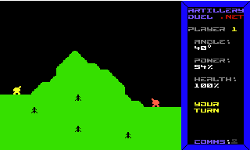
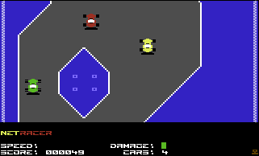
History
Artillery Duel Network (2006)
Turn-based
One on one
Minimal game world
NetRacer (2008)
Realtime
Multiplayer
Introduced a server
Larger but static game world
Ready to tackle something more ambitious! (2013)
Realtime
“Massively” multiplayer
Dynamic, massive game world
Server-controlled entities
More complex gameplay with multiple goals, encouraging teamwork

Slide 4

How massive? Target 10,000 screens

Slide 5
Inspiration
Vortex (C64)
Zone Ranger (C64)
Fort Apocalypse (C64)
Subspace (PC)
Minecraft (PC)

Slide 6
Technical Challenges
Finding enough raster time
Handling the 8-sprite limit on C64 (can’t multiplex)
Algorithmic generation of game “universe”

Slide 7
Technical Design Decisions
Server will control bulk of game logic
Server will arbitrate collisions, actions, etc.
Screen and sprite data to be “streamed” by server to C64 clients in real-time (20 Hz)
Player inputs and location to be sent from C64 to server (20 Hz)

Slide 8
The Team
Leif Bloomquist (Concept, Direction, Networking, Server code)
Saul Cross (Graphics)
Bryce Wilson (Client code)
Robin Harbron (A bit of everything)
Support:
Jonno Downes (IP65 networking code)
Dan Roganti (Playtesting)

